Slide 1

SafeSide Prevention, Open Arms & Defence Joint Mini Conference
PRESENTED BY:
Dr Grant Pegg
National Manager
Open Arms – Veterans & Families Counselling
A service founded by Vietnam Veterans, now for all veterans and families
1
Notes:
Good morning everyone, my name is Dr Grant Pegg and I have recently joined Open Arms as the National Manager.
Thank you all for participating in this important opportunity to share work and plans we are pursuing together to strengthen suicide prevention across the Departments of Veterans’ Affairs and Defence. [Acknowledgements…]
DVA through Open Arms – Veterans & Families Counselling engaged SafeSide Prevention in 2019 and our journey together has been one of significant progress. This project launched amidst the bushfires of 2019 and rolled out to staff in 2020-21 during the COVID-19 Pandemic.
I would like to acknowledge our resilient and creative leadership team, regional managers, and centre-based staff for their perseverance and enthusiasm. Thank you all for keeping suicide prevention in the forefront despite so many competing demands.
I would also like to thank Dr. Pisani and the SafeSide team. Your flexible learning model and strong focus on team connection has resulted in significant momentum in otherwise challenging times.

Slide 2
Implementation
482 staff trained in SafeSide Framework
Expansion of Peer workforce
Leveraging the expertise of Peers and Clinicians to collaborate in person-centred, recovery-oriented care for veterans and families.
Overcoming the challenges of a diverse and geographically dispersed workforce through developing innovative and accessible resources and solutions.
Notes:
To date, we have trained 482 Clinicians, Peers and staff in every Centre across the country, providing a common, unifying approach to suicide prevention with which to care for clients.
We initiated this project just after the substantial expansion of our Peer workforce, so we targeted data collection toward evaluating how Peers and Clinicians would interface in small group training regarding managing suicide risk. The results surpassed our expectations. We learned that the SafeSide Framework and training provided a common language, approach, as well as modeling collaborative practice for Peers and Clinicians, leveraging their respective expertise toward person-centred, recovery-oriented care for veterans and families. Feedback from our Peers continues to inform the ongoing evolution of the SafeSide implementation to be ever more relevant for Peers in their vital role.
We aligned workflows and documentation to support our staff in using the SafeSide Framework in day-to-day practice, and developed a custom video module with SafeSide to support integrating those new processes into practice.
As with any significant change, there have been challenges and lessons learned, which we will share with Defence to assist them in planning and implementing their project with SafeSide.

Slide 3
The Future
Rollout training to Outreach Program Counsellors.
Continuing education and awareness through engagement and collaborations in forums such as this one
Embedding SafeSide in the Open Arms workforce with common language and framework
Measure success of implementation of the SafeSide framework to inform evidence based decision making
Notes:
And now we turn our sights to training our Outreach Program Counsellors - we intend to train over 1300 OPCs in the next year.
Through this expansion, we will further strengthen our system of care - creating more streamlined, collaborative care experiences for veterans and families wherever they engage with Open Arms. This will include a rigorous evaluation conducted via a randomised cluster controlled trial that will enhance our understanding of how integrating the SafeSide Framework into our practice impacts the care provided to at-risk clients.
With SafeSide being embedded in Open Arms, we are delighted that Defence will be tailoring and adopting the Framework and program. Our departments already collaborate on multiple levels toward providing an integrated system of care and transition for serving and ex-serving Australian Defence Force members and their families. The addition of a shared suicide prevention framework, language, and learning community further supports our goals and agreements in this regard.
The DVA Leadership Team is eager for the updates Defence will provide today on your plans and progress to date. We are keen to support and continue learning with you. I would now like to share with you more detail of what we’ve learned, and what’s to come.

Slide 4
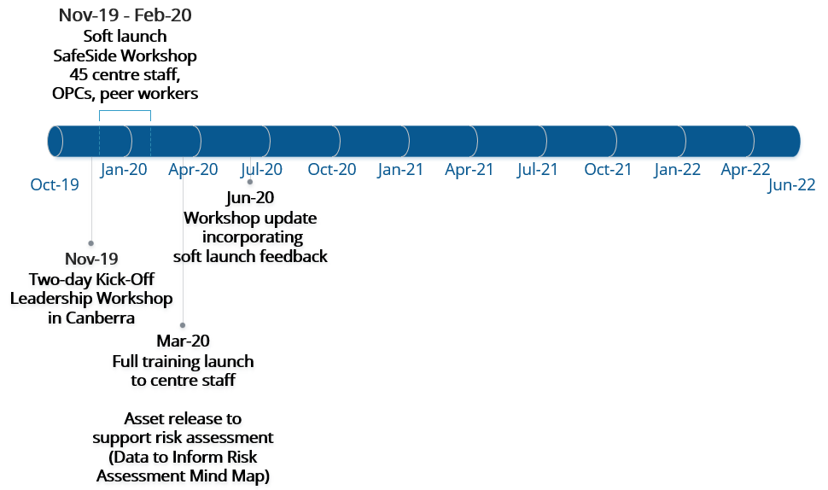
Project Accomplishments Timeline
Notes:
I will now highlight our accomplishments in implementation of the SafeSide Framework-
● In November of 2019, we began our project with SafeSide. 43 Regional leaders from across the country came to Canberra for two days with Dr Tony Pisani and Kristina Mossgraber from the Safeside Prevention team. Launching the project with an in-person event earned a lot of good will, and solidified our already-warm working relationship with Dr Pisani and his team.
● Immediately after this leadership workshop, we soft launched the workshop to 45 Regional centre staff, OPCs, and Peer workers. The goal of the soft launch was to gather feedback from staff working directly with veterans and families to inform the full rollout.
● Continuous improvement has been a hallmark of our partnership with SafeSide from the outset – so based on what we learned in the soft launch and from our leaders’ feedback, SafeSide provided additional resources to support risk assessment in March 2020 as we launched the training to centres nationally. Shortly thereafter in June 2020, SafeSide also released a workshop update to address areas of opportunity identified in the soft launch phase.

Slide 5
SafeSide InPlace Workshop Completions
Notes:
● In the initial phase of this project, we focused on staff training.
●We trained over 200 staff in the first year of the project.
●This momentum has continued, and to date, 482 Open Arms staff have completed the SafeSide training. This includes 431 Open Arms Clinical staff, Lived Experience Peers and Leadership staff, 36 Business Support staff, and 15 Outreach Program Counsellors.

Slide 6
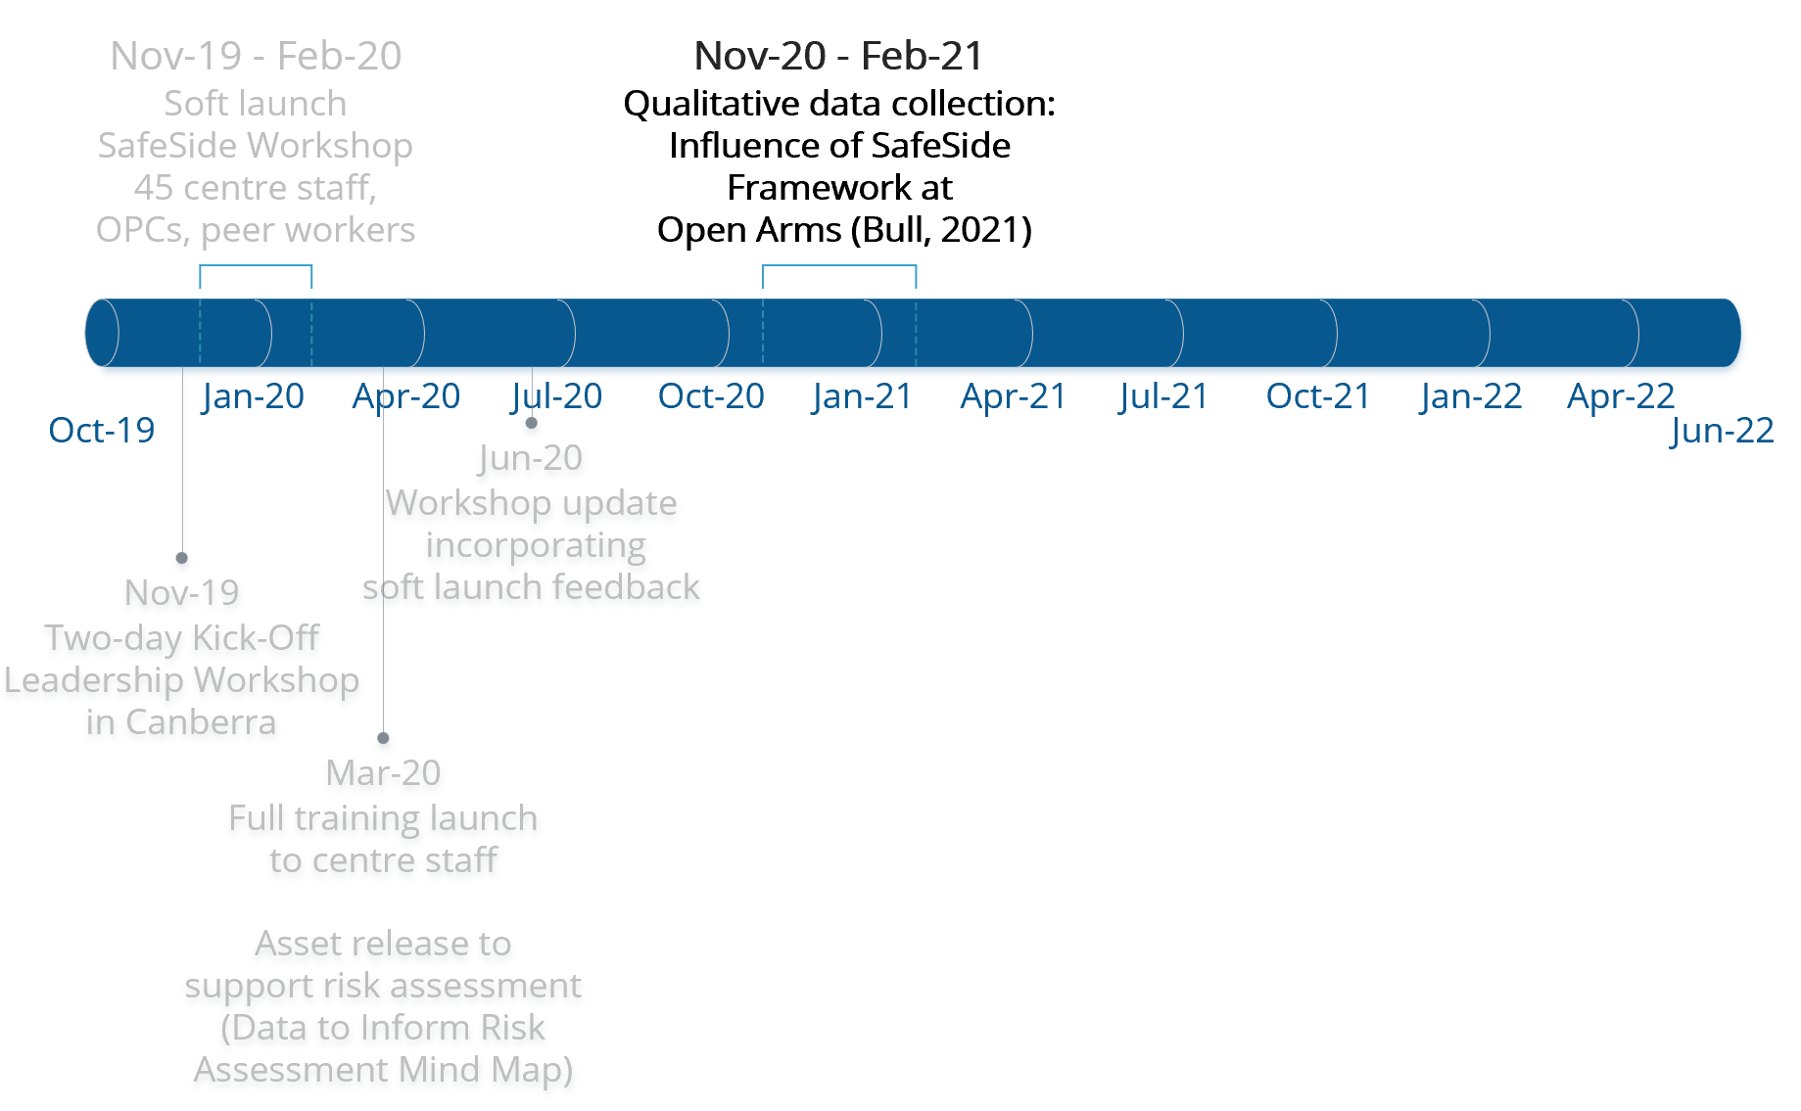
Project Accomplishments Timeline
Notes:
● As I’ll show in greater detail in a moment, early post-workshop evaluation data from SafeSide indicated staff were finding the content transferrable to their diverse roles, and that the training modules were translating to tangible outcomes for our workforce.
● After a strong focus on staff training for the first year, Dr. Donna Bull, Assistant Director - Clinical Initiatives, conducted a rich, qualitative study with the goal of better understanding the nature and extent of the influence of SafeSide at Open Arms.

Slide 7
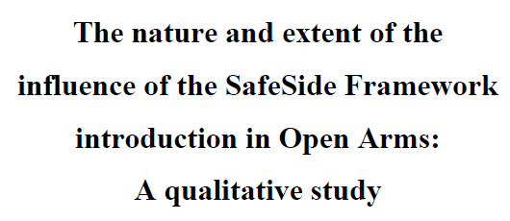
Enriching Communication with Colleagues
There’s a common language across the different stakeholder groups. It’s a useful framework for case conceptualisation with Peers and Clinicians. We’re unpacking more, it’s not just suicide. It’s less forensic, a nice entry point to a conversation with a client, particularly for our non-clinical people.
(Bull, 2021)
Themes:
Strengthened professional identity and sense of belonging
Enthusiasm for practice change waned overtime without infrastructure, systems and documentation to embed the framework
Learning the clinical language has been a barrier to being a Peer Worker, we’re becoming comfortable and SafeSide assists this. I’m definitely more confident, comfortable now going to a Clinician with my assessment, plans, etc
Notes:
● From interviews with Leaders, Clinicians, and Peers, two main themes emerged:
1) First, we learned the initiative has had an impact on strengthening professional identity and sense of belonging for Open Arms staff, including enriching communication with colleagues. This finding was hugely encouraging that we were making progress, not only in training, but in positively impacting organisational culture.
Quotes reveal that staff embraced the framework as a common language and approach. For example, one participant said:
‘There’s a common language across the different stakeholder groups. It’s a useful framework for case conceptualisation with Peers and Clinicians. We’re unpacking more, it’s not just suicide. It’s less forensic, a nice entry point to a conversation with a client, particularly for our non-clinical people.' (19)
We were equally encouraged to learn that there was also strong buy in from our Peer workforce. One Peer noted:
‘Learning the clinical language has been a barrier to being a Peer Worker, we’re becoming comfortable and SafeSide assists this. I’m definitely more confident, comfortable now going to a Clinician with my assessment, plans, etc’
-----CLICK NOW - THERE IS AN ANIMATION FOR point 2.-----
2) Dr Bull also uncovered a missed opportunity, which I’ll note later when we get to lessons learned: Many informants in Dr Bull’s study had a high level of motivation to use the framework in their respective roles following completing the modules. However, over time, this enthusiasm waned in the absence of supporting infrastructure and systems, including aligned documentation, to support incorporating the skills in their work.

Slide 8
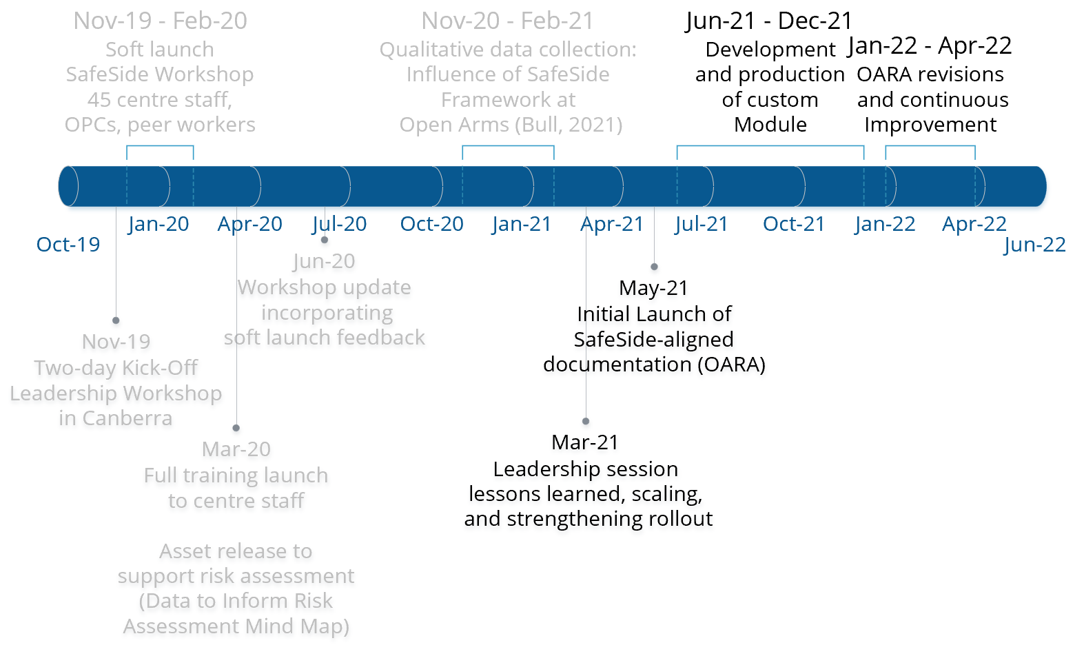
Project Accomplishments Timeline
Notes:
● A leadership session was held in March 2021 to review the project to date. In this session, Dr Bull presented findings from her study and Drs. Pisani and Donovan from SafeSide presented evaluation data from Open Arms.
● There was consensus to move quickly to revise our risk assessment and planning documentation. The revised documentation, called the Open Arms Risk Assessment or OARA, operationalises key skills in the SafeSide Framework in documentation staff will use in their day-to-day work, supporting learning transfer and skills generalisation. The aligned documentation was released in May 2021.
● To further address these findings, we worked with SafeSide Prevention to create a custom module walking staff through the use of the OARA and how it supports integration of SafeSide in day-to-day practice. We anticipate releasing this module in the coming months as we are in the midst of a continuous improvement cycle to update and revise the OARA based on feedback from our Clinical and Peer workforce.

Slide 9
Learning Transfer
Workshop is relevant and transferable to job/role
 | % Agree or Strongly Agree
Learning Transfer Item | All | Peers
Activities helped me know how to apply my learning | 88.7 | 86.1
Developers understand how I will use what I learn | 85.8 | 77.7
Examples showed me how I could use my learning | 89.4 | 91.6
Material made me feel more confident I could apply it | 86.4 | 86.1
What is taught closely matches my practice requirements | 90.1 | 86.1
Situations in this training are similar to my job | 71.5 | 63.9
Will use this training on my job | 94.7 | 94.4
Knew what to expect | 60.3 | 36.2
*Using this will take too much energy away from my other work | 5.6 | 13.9
Training will help me do my job better | 90.9 | 88.9
Good understanding of how this training will fit my job-related development | 90 | 88.9
Notes:
● Around the same time we rolled out SafeSide, we expanded our Peer workforce. An additional focus of this project and the March 2021 Leadership session was understanding how Peers were being included in this initiative, and how participating in the workshop may facilitate the collaboration of Peers and Clinicians in serving those at risk.
● SafeSide Prevention shared data to indicate that Peers, Clinicians and other staff find the content of training modules highly transferable to their roles.
----CLICK (animation): 89% of staff, and 86% of Peers indicated the activities in the workshop helped them know how to apply their learning -----
----CLICK (animation): 86% of staff, and 86% of Peers indicated the material made them feel more confident regarding its application ------
-----CLICK (animation): And 90% of staff, and 89% of Peers indicated the workshop will help them do their job more effectively ------
● These trends have further increased our confidence that the collaboration of Peers and Clinicians has been strengthened with the common language and approach provided by the SafeSide Framework.

Slide 10
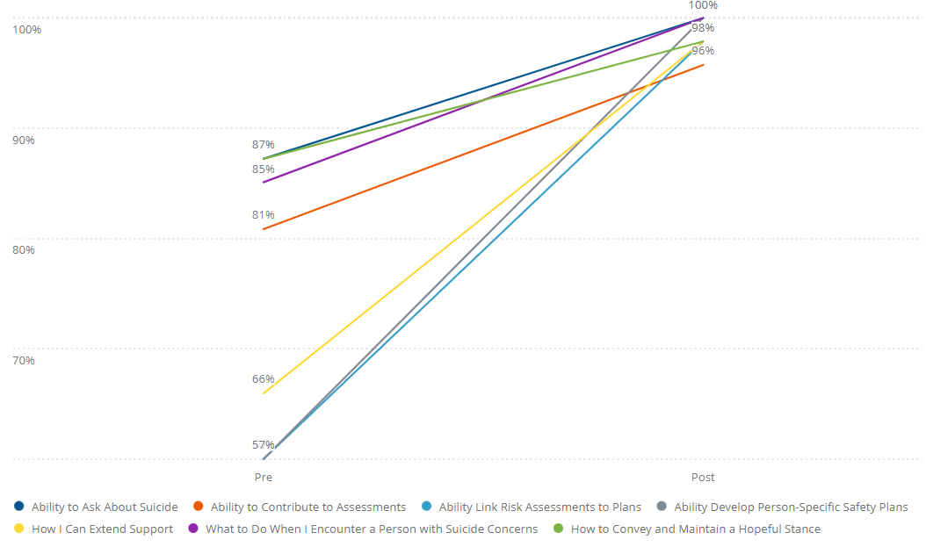
What percentage endorsed agree or strongly agree on self-efficacy items?
Self-Efficacy
A person’s belief in their ability to engage in a behavior
Increase likelihood of incorporating skills into work
Notes:
● As we continue to train our centre-based staff and Peer workforce, SafeSide’s robust evaluation data and feedback from our workforce helps us learn more about the impact of this project and envision additional ways to strengthen and improve the impact of this project.
● For example, self-efficacy in key suicide prevention skills in the SafeSide Framework consistently increase from pre- to post-evaluation. Of note, the largest increases have been related to strengthening person-specific plans for those at risk.
The percentage of staff agreeing or strongly agreeing they were confident in their ability to include means safety and plans for specific life events that would increase risk increased from 57.45% to 100% following the training (ref: grey line)
Staff are also more confident in their ability to extend support to veterans and families at risk beyond when they are in contact – this improved from 66% agreeing or strongly agreeing to 98% agreement following the training (ref: yellow line)
● These improvements in self-efficacy increase our confidence that staff will integrate these skills into their work following the training.

Slide 11
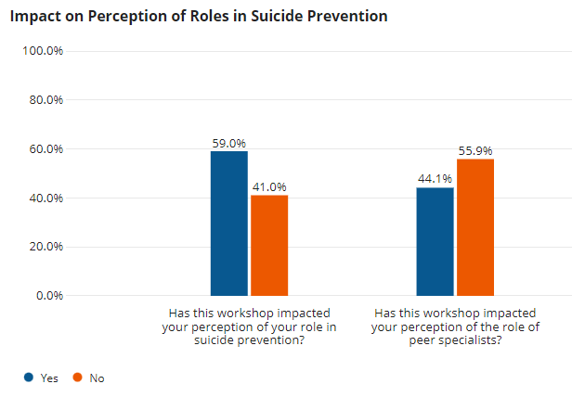
How did it impact your perception?
That every interaction is an intervention
Now [I] better understand peer worker’s role in identifying risk and escalating cases as well as their capacity to support clients and note significant behavioral changes and potential supports and risks in client’s network
[It is] now clearer how they [peers] can assist.
Notes:
● As can be seen here (first blue bar) 59% of all participants indicated participation in the training impacted their perception of their role in suicide prevention – this is a powerful number when you consider that to date most staff trained at Open Arms were experienced Clinicians with prior training in suicide prevention.
●Similarly, 44% (second blue bar) of participants indicated that participation in the training impacted their perception of the role of Peer workers. This is clear evidence that participation in the training equates to shifting attitudes toward Peers for a major segment of our workforce.
● When asked respondents to explain how it impacted perception we heard that
-’every interaction is an intervention.’
-’Now [I] better understand Peer worker’s role in identifying risk and escalating cases as well as their capacity to support clients and note significant behavioural changes and potential supports and risks in client’s network.’
-’[It is] now clearer how they [Peers] can assist.’

Slide 12
Name one thing you will take into your everyday work.
Open Ended Responses: Themed Aligned to Framework
Connect (6) Ask directly (5) Collaboration (4) Commit (2) | Foreseeable changes (37) Data to inform risk assessment (10) Risk status/risk state (10) Dynamic/contextual view of risk (9) Prevention and planning rather than prediction (3) | Develop contingency plans (18) Mini-interventions (11) Radical empathy/hope (4) Collaboration and comprehensive planning (2) Increased structure in safety plans (2) | Involve family/family support plans (9) Extend and follow up (9) Increased/expand support networks (5)
“Relax and connect naturally” “Helping clients through the pain” “Compassion” | “The importance of foreseeable changes and contingency planning” “Shared understanding of risk formulation” “A more dynamic view of what creates risk for individuals” | “Don’t be so quick to respond. Listen and take it all in.” “Continuing to be radically empathetic and honest with clients to ensure their safety…” “Contingency planning around foreseeable crisis that may occur” | “Collaboration with both professional and family/friends connections” “Extension. Love it. Looking at how we can extend our care for the individual at risk…”
Notes:
● Open-ended responses on the post-training evaluation further insight into the specific skills staff are planning to integrate into their work. This is a summary of a thematic analysis conducted at the halfway point of this project, which highlights:
That staff have takeaways that cut across all four core tasks of Connect, Assess, Respond and Extend.
The most prominent themes included integrating foreseeable changes and contingency plans into assessments and responses to risk, followed by mini-interventions that skill our staff with immediate, concrete, evidence-based strategies to support a person at-risk.
● Considering these two outcomes, this data for us is very positive – though we have much more work to do, these are all indicators that we are having a positive and tangible impact. We are shifting culture. We are uniting, collaborating, and strengthening the way we connect with and support veterans and families at risk.
● We continue to sustain the training of our centre-based staff and Peer workforce. AND - we are entering a new phase of this project, where we will focus on expanding training to our Outreach Program Counsellors – further strengthening the integration and cohesive care experience for those at risk. This phase of the project includes an additional rigorous evaluation, about which Dr. Pisani will share more shortly.

Slide 13
Lessons Learned
A common framework and approach → enhanced sense of organizational belonging (Bull, 2021)
Diverse teams benefitted from participation together – helped clarify and evolve perception of the role of peer workers at Open Arms in suicide prevention
Missed Opportunity - strong desire to immediately implement after inspiring workshop, but systems weren’t in place
  Suggest: earlier development of aligned policies, workflows, and documentation to support learning transfer immediately
  Leverage continuous improvement cycle to strengthen
Notes:
● In summary – what have we learned?
- We’ve learned that SafeSide strengthened professional identity and the sense of belonging for staff, enriching colleague communication.
- We’ve learned that the SafeSide Framework has been positively received by our diverse staff group, including our Peer workforce.
- We’ve learned that the SafeSide Framework is creating a space for dialogue and collaboration for Clinicians and Peer workers and we intend to continue to strengthen and expand our implementation and effort to further unify this work. So no matter with who our clients come in touch, they encounter hopeful, recovery-oriented care.
- We’ve learned that we need infrastructure and documentation to support the training in order to maintain momentum and buy in, and to help solidify immediate translation of skills into practice. We are revising documentation, and are working tenaciously to continue to improve systems and resources in order to better support staff to consolidate practice improvement and seamlessly adopt the Safeside Framework.

Slide 14
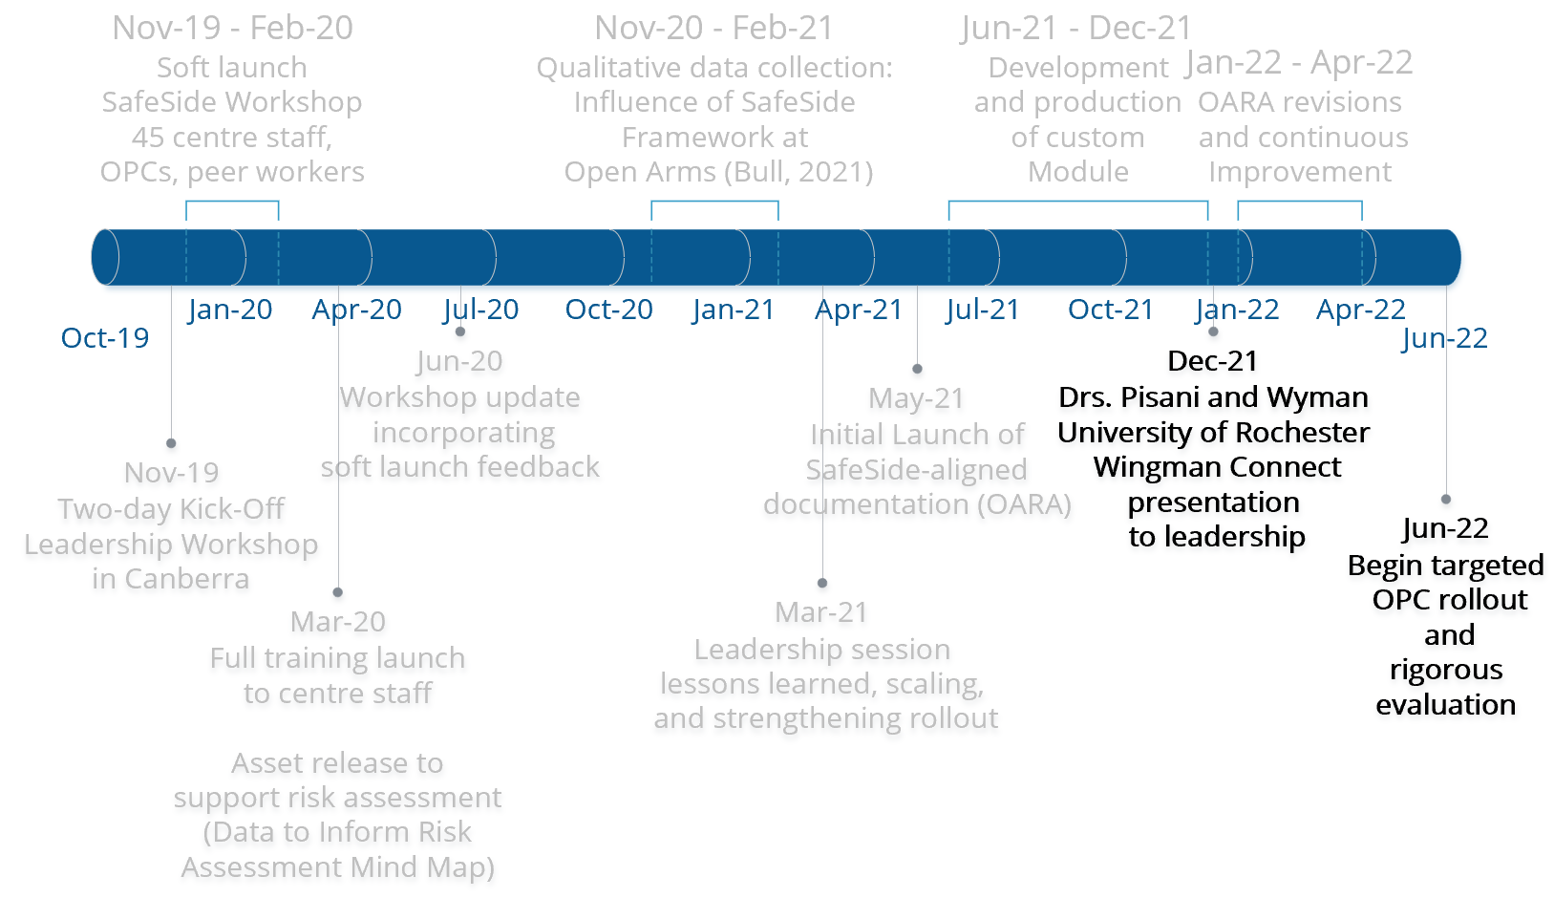
Project Next Steps
Notes:
● In January 2021, Dr Pisani and his colleague, Dr Wyman shared a presentation with Defence and DVA Leadership regarding Wingman Connect - a network health intervention designed to strengthen bonds, cohesion, and adaptive coping norms (Wyman et al, 2020). With an eye on how these prevention efforts could span current and ex-serving ADF members, Open Arms is enthusiastic for further discussion regarding these opportunities.
● Our most immediate task is to finalise revisions to our documentation and launch the custom module we developed with SafeSide Prevention – this launch will serve as a refresher for staff who have been trained earlier in the project and an opportunity to re-energise teams with that link between training and documentation for which they have asked.
● We have had staff attend Garrison Health Centre Visits, and the Illawarra Shoalhaven Local Health District lived experience workshops over recent weeks.
● We are encouraged and energised with all we’ve accomplished to date; we now turn to training our OPCs while sustaining the training for our centre-based staff. In the coming months, we intend to train over 1300 OPCs, with a vision of strengthening our system of care further. As Dr. Pisani mentioned, rigorous scientific evaluation of the impact of our OPC initiative will be conducted in partnership with Dr. Batterham at The Australian National University.

Slide 15

Notes:
Any questions?
Thank you for your time and contributions and we look forward to working collaboratively with our Defence colleagues.

